Slide 1
POSIX Threads and Mutex
Session 15

Slide 2
Agenda
Pthreads Overview
The Pthreads API
Compiling Threaded Programs
Thread Management
Mutex Variables
Condition Variables

Slide 3
Thread
Independently executable entity because it has following info with it
Stack pointer
Registers
Scheduling properties (such as policy or priority)
Set of pending and blocked signals
Thread specific data.
What it gets from process
Global data
Access to code area
Heap (pointers should be globally accessible)

Slide 4
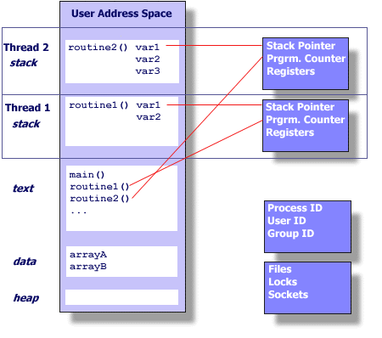
Thread

Slide 5
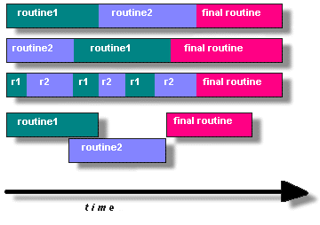
Threads execution

Slide 6
Child
Child
int global = 20;
main() {
int local = 10;
pid_t pid = fork();
if ( pid == 0 ) {
// child
global += 5;
local += 5;
} else if (pid > 0) {
// parent
global += 10;
local += 20;
} else { // print failed }
//print global and local and see what happens
}

Slide 7
Thread
Thread
int global = 20;
void * subroutine(void *)
{
// Thread tasks
global += 5;
print global;
pthread_exit((void *)retvalue); // terminating
}
// Main thread
main() {
int local = 10;
call pthread function (pthread_create) to create thread with subroutine as its code
global += 10;
print local and global;
call pthread_exit(); // To indicate that I am waiting for threads to get finished
}

Slide 8
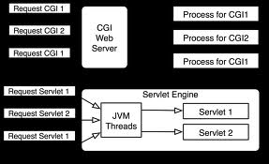
Process vs Thread
It takes more time to create process than thread
oh am I missed context switch
Multi-Threaded vs Multi-Process application

Slide 9
Pthreads Overview
What is Thread?
Should be somewhat clear by now
What is Pthreads?
Standardization of threads IEEE POSIX 1003.1c
Why Pthreads?
Each vendor came up with his own version of threads standardization was
important
Designing Threaded Programs

Slide 10
Caution while using threads
Changes made by one thread to shared system resources (such as closing a file) will be seen by all other threads.
Two pointers having the same value point to the same data.
Reading and writing to the same memory locations is possible, and therefore requires explicit synchronization by the programmer

Slide 11
The Pthreads API
The subroutines which comprise the Pthreads API can be informally grouped into following major groups
Thread management (Creation, Joining etc.)
starts with pthread_<activity/type> e.g. pthread_t, pthread_create(),
pthread_join() etc.
Thread attributes (init, destroy)
starts with pthread_attr_<activity/type> e.g. pthread_attr_t, pthread_attr_init(), pthread_attr_destroy() etc
Mutexes (lock and unlock)
starts with pthread_mutex_<activity/type> e.g. pthread_mutex_t, pthread_mutex_lock(),
pthread_mutex_destroy()
Condition variables(wait and signal)
starts with pthread_cond_<activity/type> e.g. pthread_cond_t, pthread_cond_lock(),
pthread_cond_destroy()

Slide 12
Thread Management
Creating and Terminating Threads
Creating threads
int pthread_create(pthread_t *thread, const pthread_attr_t *attr,
void *(*start_routine) (void *), void *arg);
Exiting
void pthread_exit(void *retval);
Pthread attributes
pthread_attr_t
int pthread_attr_init(pthread_attr_t *attr);
int pthread_attr_destroy(pthread_attr_t *attr);
Passing Arguments to Threads
Joining and Detaching Threads
int pthread_join(pthread_t thread, void **retval);
int pthread_detach(pthread_t thread);

Slide 13
Creating threads
pthread_create() routine
void * routine(void *arg) {
// Thread activities
// casting for arg
}
int main() {
pthread_t threadid;
pthread_attr_t thread_attr;
pthread_attr_init(&thread_attr);
int arg;
int rc = pthread_create(&threadid, &thread_attr, routine, (void *) arg);
if ( rc ) {
printf(“pthread_create() : failed.\n”);
exit(-1);
}
pthread_exit(0);
}

Slide 14
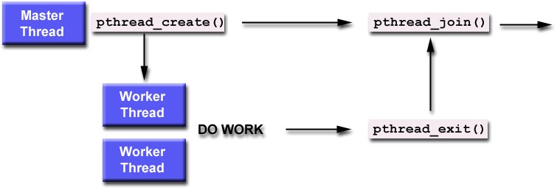
Joining thread

Slide 15
Joining threads
What it means to join for a thread ?
Which threads are joinable
PTHREAD_CREATE_JOINABLE attribute value in pthread_attr_setdetachstate()
Calling pthread_join on thread
void * thread_routine(void *arg) { // Thread activities }
main {
pthread_t threadarr[5]; void *status;
int i, rc;
pthread_attr_t attr; pthread_attr_init(&attr);
pthread_attr_setdetachstate(&attr, PTHREAD_CREATE_JOINABLE)
for ( i = 0; i < 5; i++) {
rc = pthread_create(&threadarr[i], NULL, thread_routine, NULL);
//check rc }
for ( i = 0; i < 5; i++) {
rc = pthread_join(threadarr[i], &status);
// check rc }
pthread_exit(0);
}

Slide 16
Mutex Variables
Mutex Variables Overview
Why Mutexes
Creating and Destroying Mutexes
pthread_mutex_t, pthread_mutexattr_t
Destroy
int pthread_mutex_destroy(pthread_mutex_t *mutex);
Initialize
int pthread_mutex_init(pthread_mutex_t *restrict mutex,
const pthread_mutexattr_t *restrict attr);
pthread_mutex_t mutex = PTHREAD_MUTEX_INITIALIZER;
Locking and Unlocking Mutexes
How to use them
int pthread_mutex_lock(pthread_mutex_t *mutex); // blocking lock
int pthread_mutex_trylock(pthread_mutex_t *mutex); // non blocking lock
int pthread_mutex_unlock(pthread_mutex_t *mutex); // unlock

Slide 17
Thread and mutexes
pthread_mutex_
pthread_mutex_t mutex;
int global_data;
// I may have some other routine for creating thread for some diff purpose accessing
// and modifying global data
void * thread_routine1(void *) {
pthread_mutex_lock(); // Lock
// do something on global_data
pthread_mutex_unlock() // Unlock
}
main() {
pthread_mutex_init(&mutex, NULL /*ptr to pthread_mutex_attr_t */) // Initialization
// create threads with thread_routine1 as code of thread
// cleanup, destroy attributes, mutexes etc.
}

Slide 18
Condition Variables
Condition Variables Overview
mutex is not enough to handle certain situations
pthread_cond_t, pthread_condattr_t
Creating and Destroying Condition Variables
int pthread_cond_destroy(pthread_cond_t *cond); // Destroy condition variable
int pthread_cond_init(pthread_cond_t *restrict cond,
const pthread_condattr_t *restrict attr); // initialization using pthread_condattr_t
pthread_cond_t cond = PTHREAD_COND_INITIALIZER; // initialization using macro(static)
Waiting and Signaling on Condition Variables
int pthread_cond_timedwait(pthread_cond_t *restrict cond,
pthread_mutex_t *restrict mutex,
const struct timespec *restrict abstime); // Waiting for certain time period
int pthread_cond_wait(pthread_cond_t *restrict cond,
pthread_mutex_t *restrict mutex); // waiting infinitely
int pthread_cond_broadcast(pthread_cond_t *cond); // signalling all waiting threads
int pthread_cond_signal(pthread_cond_t *cond); // Signalling only one waiting thread
Used in conjunction with mutex

Slide 19
PThread condition variables
Main Thread Declare and initialize global data/variables which require synchronization (such as "count") Declare and initialize a condition variable object Declare and initialize an associated mutex Create threads A and B to do work
Thread A Do work up to the point where a certain condition must occur (such as "count" must reach a specified value) Lock associated mutex and check value of a global variable Call pthread_cond_wait() to perform a blocking wait for signal from Thread-B. Note that a call to pthread_cond_wait() automatically and atomically unlocks the associated mutex variable so that it can be used by Thread-B. When signalled, wake up. Mutex is automatically and atomically locked. Explicitly unlock mutex Continue | Thread B Do work Lock associated mutex Change the value of the global variable that Thread-A is waiting upon. Check value of the global Thread-A wait variable. If it fulfills the desired condition, signal Thread-A. Unlock mutex. Continue
Main Thread Join / Continue

Slide 20
PThread condition variables
Global variables int count = 0; int thread_ids[3] = {0,1,2}; pthread_mutex_t count_mutex; pthread_cond_t count_threshold_cv;
Main Thread pthread_mutex_init(&count_mutex, NULL); pthread_cond_init (&count_threshold_cv, NULL); // Create thread A and Thread B
Thread A pthread_mutex_lock(&count_mutex); while (count < <threshold value>) { pthread_cond_wait(&count_threshold_cv, &count_mutex) // use/update count } pthread_mutex_unlock(&count_mutex); | Thread B pthread_mutex_lock(&count_mutex); // update count if (count == <threshold value>) pthread_cond_signal(&count_threshold_cv) pthread_mutex_unlock(&count_mutex);
Main Thread //Join thread A and B // Perform cleanup

